Slide 1
MCGSS Annual General Assembly
Welcome!
http://mcgss.weebly.com/

Slide 2
Results of your MCGSS nominations
President: Marcus Kaji
Vice president: Mi Lin
Treasurer: Sripad Joshi
Secretary: Georgia Limniatis
Public Relations Officer: Harpreet Singh
MCSS rep:
Faculty rep: Guillermo Portillo
Environmental Advisor: Bhalamurugan Gatamaneni Loganathan

Slide 3
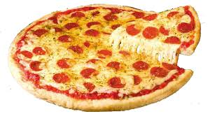
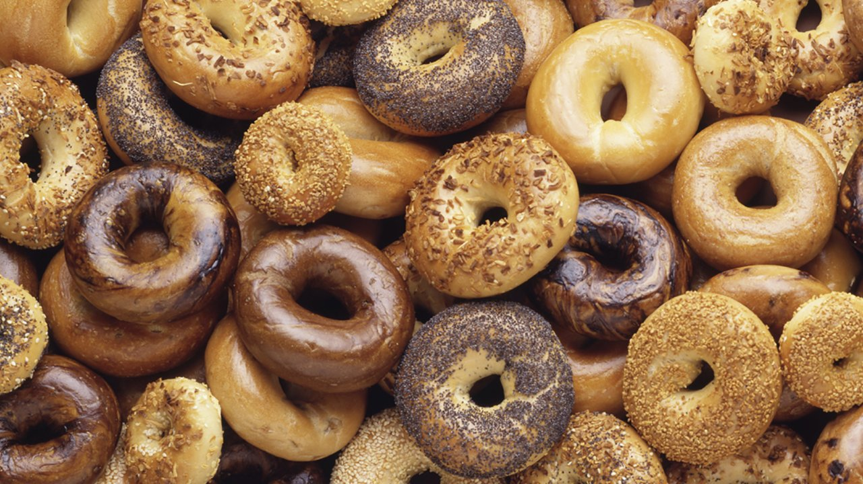
Georgia Limniatis georgia.limniatis@mail.mcgill.ca
Public relations officer
Tasks;
Answering the MCGSS email
Putting together and sending out newsletters
Sending out event information and reminders

Slide 4
Mahsa Ghasri mahsa.ghasri@mail.mcgill.ca Vice-President

Slide 5
Marcus Kaji, Advisor for all things environmental
Marcus.kaji@mail.mcgill.ca
I have been involved in:
Trivia night (WE NEED MORE ATTENDANCE)
Summer softball: (WE NEED MORE PEOPLE)
Fall and Winter Orientation
Strawberry social, sustainable BBQ
Bagel breakfast deal with compost and
I FIXED the FOOSEBALL TABLE
BOATHOUSE
Committees:
Sub-committee of physical development
Parasitology faculty meetings
Faculty meetings
PGSS council and GM meetings: they just had their GM and did not reach
quorum…

Slide 6
What do you want from us?
RANT: How many of you have sat on a committee?
Now how many of you hope to get a job after you graduate??
How do you think academia/industry/workplaces operate?
Experiences with bureaucracy is a necessity (and easy/often minimal time commitment)

Slide 7
Jessica Pawly jessica.pawly@mail.mcgill.ca Secretary
Record Minutes
Book Rooms
Keep Council Happenin’ and Hip
Provide Support
{Currently writing everything you say…}

Slide 8
Alexandre Martel alexandre.martel@mail.mcgill.ca Representative to MCSS (undergrads)

Slide 9
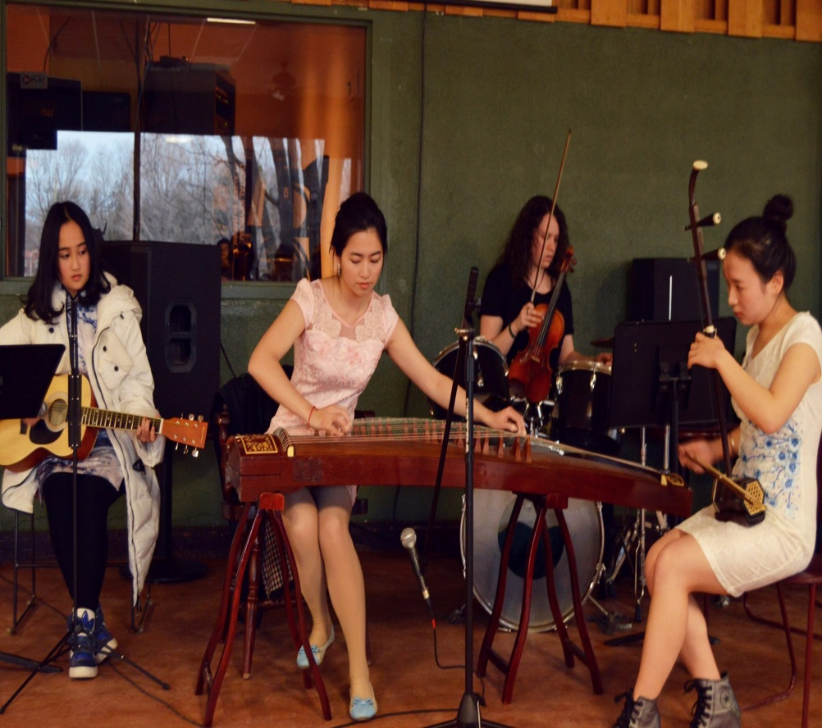
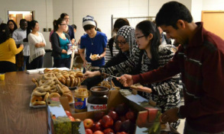
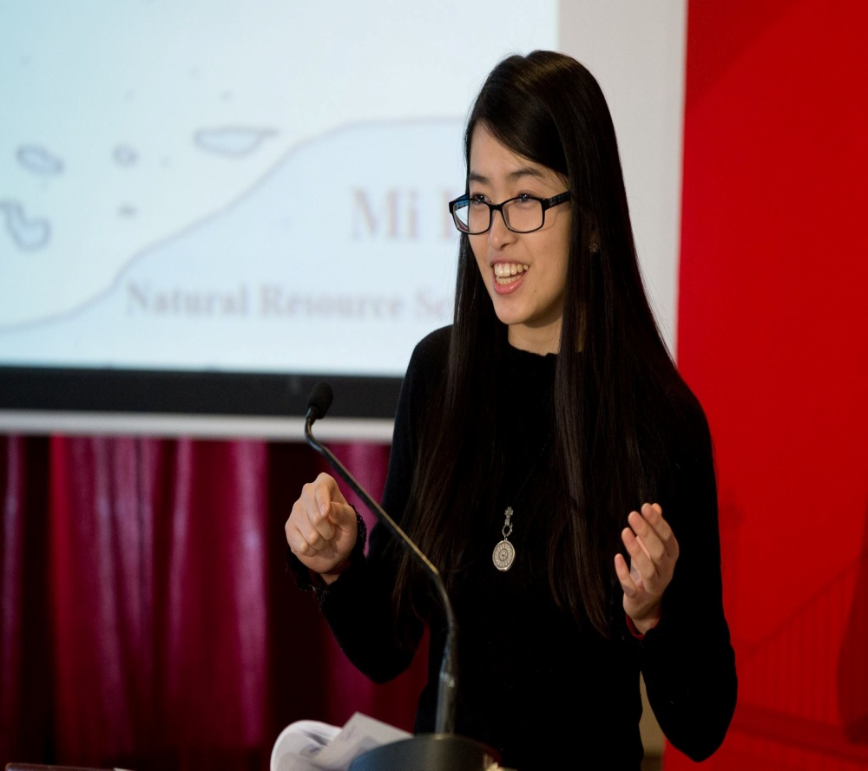
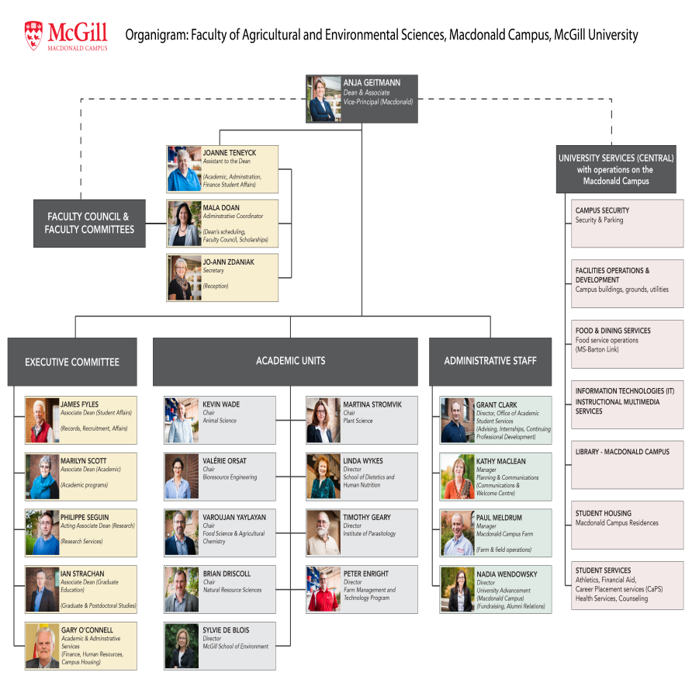
Mi Lin mi.lin@mail.mcgill.ca
Faculty Representative
Faculty Meeting
Bagel Breakfast
Orientation (Mac Music Club + MCGSS)
Grad Connect Cafe (CaPS) + Bagel Breakfast (MCGSS)

Slide 10
Jaaved Singh MCGSS President
8 Committees McGill Wide
Duties and Accomplishments for MAC students
Immigration Advisor on Campus
Counselling services 4 times a week
Reconnecting to Peer Helper Program
Supporting Ekta on expanding Healthy McGill
Supporting Louise/Marcus on Spin Bikes
Designing Student Services Survey
Supporting Founder’s Day and 3MT competition
Fall Orientation Canoe Race
Winter Orientation at MAC
Lead Lab Visits for Student Services
Promoting Paddle Boat project with Marcus
2 Health Focused Projects with PGSS Health Commissioner
Investigating how TA Awards are nominated
MAC Voice at McGill Senate
Meaningful Science Project with fellow McGill Researcher

Slide 11
Financial Report 2016-2017
MCGSS Annual General Assembly
March 23rd 2017
Gabriel Lambert-Rivest, Treasurer
gabriel.lambert-rivest@mail.mcgill.ca

Slide 12
Macdonald Campus Graduate Students' Society Budget - Annual Breakdown
Period: 2016-2017 |  |  | Budget |  | Current situation
Student Council Revenues:
 |  | Fees | $ - |  | $0.00
 |  | PGSLF 30% | $ 3,773.10 |  | $ 3,773.10
 |  | Dean | $ 600.00 |  | $833.81
 |  | PGSS | $ 325.00 |  | $125.00
 |  | Other | -
 |  | Total revenues | $ 4,698.10 |  | $ 4,731.91
Student Council Expenses:
Events Total |  |  | $ 4,460.00 |  | $2,880.27
 |  | Bagel breakfast | $ 1,760.00 |  | $1,435.93
 |  | Food Events | $ 650.00 |  | $533.81
 |  | Drink Events | $ 550.00 |  | $0.00
 |  | Orientation Events | $ 900.00 |  | $876.05
 |  | Others | $ 600.00 |  | $34.48
Council & Exec Meetings |  |  | $ - |  | $0.00
Travel Grants |  |  | $ - |  | $900.00
Fund requests (Clubs) |  |  | $ - |  | $0.00
Bank Account (CIBC) |  |  | $ 80.00 |  | $76.66
Grad Room Improvement |  |  | $ 100.00 |  | $0.00
Peer Helper Program |  |  | $ - |  | $0.00
Other |  |  | $ 200.00 |  | $0.00
 |  | Total | $ 4,840.00 |  | $3,856.93
Final Balance:
Sub total |  |  | -$ 141.90 |  | -$ 141.90
 |  | Previous Surplus (15-16) |  |  | $ 6,360.36
 |  | PGSLF Surplus |  |  | $ 5,426.90
Net Balance |  |  | -$ 141.90 |  | $ 11,645.36

Slide 13
Macdonald Campus Graduate Students' Society Budget - Annual Breakdown
Period: 2014-2015 |  |  | Budget |  | Current situation
Student Council Revenues:
 |  | Fees | $ 16,500.00 |  | $16,496.75
 |  | Dean | $ 600.00 |  | $600.00
 |  | PGSS | -- |  | $650.00
 |  | Other | -- |  | $0.00
 |  | Total revenues | $ 17,100.00 |  | $ 17,746.75
Student Council Expenses:
 |  | Orientation | $ 4,000.00 |  | $1,547.68
 |  | Activities | $ 4,000.00 |  | $4,652.59
 |  | Bagel breakfast | $ 1,500.00 |  | $2,071.07
 |  | Travel Grants | $ 3,000.00 |  | $2,900.00
 |  | Council Rep. Meeting | $ 1,000.00 |  | $1,395.12
 |  | Executive Expenses | $ 250.00 |  | $0.00
 |  | Fund requests (Clubs) | $ 1,500.00 |  | $1,496.88
 |  | Bank Account (CIBC) | $ 200.00 |  | $81.30
 |  | Donations | $ 600.00 |  | $326.00
 |  | Grad Room Improvement | $ 500.00 |  | $245.93
 |  | Peer Helper Group | $ 1,840.00 |  | $1,840.00
 |  | Corn Roaster | $ 500.00 |  | $380.63
 |  | Other | $ - |  | $100.00
 |  | Total Student Council Events | $ 18,890.00 |  | $17,037.20
Final Balance:
Sub total |  |  | -$ 1,790.00 |  | $ 709.55
 |  | Previous Surplus (13-14) |  |  | $ 8,072.21
 |  | PGSLF Surplus |  |  | $3,778.20
Net Balance |  |  | -$ 1,790.00 |  | $ 12,559.96

Slide 14
Macdonald Campus Society's PGSLF Annual Breakdown
Department | Current Situation
Agricultural Economics | $139.72
Animal Science | $256.13
Biotechnology | $588.82
BREE | $3702.58
Diet. and Human Nutr. | $2155.68
Food Science | $909.75
Natural Resource Science | $1866.26
Parasitology | $113.19
Plant Science | $917.96

Slide 15
Term | Code | Description | Charge
Fall 2016 | PGDE | PGSS Dental Plan | $176.87
 | PGEF | PGSS Needs-Based Bursary Fee | $1.01
 | PGGP | PGSS Grants Program Fee | $2.07
 | PGHE | PGSS Health Plan | $242.19
 | PGLF | PGSS Library Improvement Fund | $3.00
 | PGLS | PGSS Legal Support Fee | $1.01
 | PGPR | PGSS Special Projects Fee | $4.60
 | PGSL | PGSS Student Life Fund | $10.10
 | PGSP | PGSS Thomson House Trust | $0.76
 | PGSS | PGSS (Graduate Students' Soc) | $32.82
Sub-Total |  |  | $474.43
Winter 2017 | PGEF | PGSS Needs-Based Bursary Fee | $1.01
 | PGGP | PGSS Grants Program Fee | $2.07
 | PGLF | PGSS Library Improvement Fund | $3.00
 | PGLS | PGSS Legal Support Fee | $1.01
 | PGMK | Midnight Kitchen Fee - PGSS | $0.75
 | PGPR | PGSS Special Projects Fee | $4.60
 | PGSL | PGSS Student Life Fund | $10.10
 | PGSP | PGSS Thomson House Trust | $0.76
 | PGSS | PGSS (Graduate Students' Soc) | $32.82
Sub-Total |  |  | $56.12
Total |  |  | $530.55
Term | Description | Charge
Fall | Dental plan (MCSS)* | $114.61
 | Health plan (MCSS)* | $92.06
 | Grad lounge fee | $1
 | PGSLF | $10
 | Operation and activities fee | $10.24
 | Travel Grant Fund | $4.76
 | MCSS services | $11.00
Sub-total |  | $243.77
Winter | Grad lounge fee | $1
 | Operation and activities fee | $10.24
 | Travel Grant Fund | $4.76
 | PGSLF | $10.10
 | MCSS services | $11.00
Sub-total |  | $37
Total |  | $280.87
PGSS-Current situation
MCGSS-Projected situation

Slide 16
Separation
History
Structure
Representation and Locality
Social Activities
Money Bank
Internal Bureaucracy of PGSS
Examples within McGill

